Slide 1
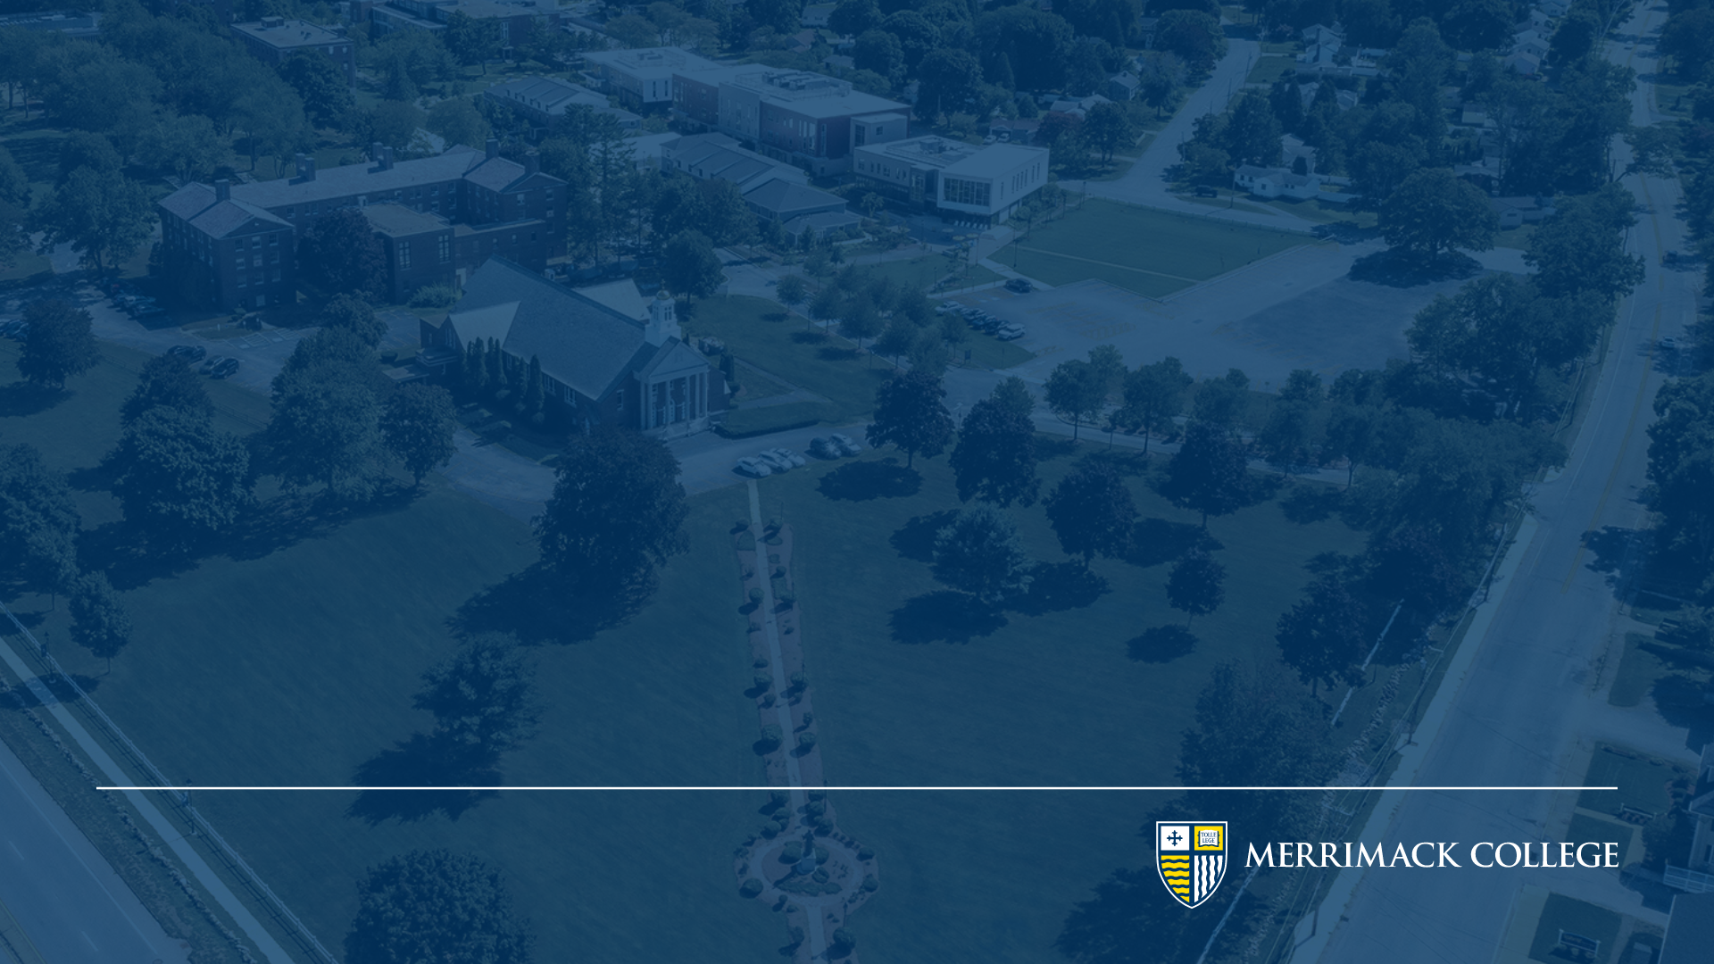
DSE6212
Text and Image Mining
Session # 5
Agarwal

Slide 2
Sequence to Sequence Models

Slide 3
Introduction to Seq 2 Seq
RNN’s were introduced to handle the sequential nature of text data which allowed them to improve on the outcome of word embeddings approach of Word2Vec and GloVe
RNN’s suffered from vanishing and exploding gradients as the text got longer and introduction of LSTM improved on that limitation by using gates – mechanism to decide what to keep or forget
“A curious cat climbed a tall tree to chase a bird, but the bird flew away.”
LSTMs excel in capturing dependencies like A curious cat but struggle with long –range dependencies like chase a bird because they rely on fixed-size hidden state to store all information, which becomes a bottleneck for longer or more complex stories
Consider another example in text translation:
Input (English): “The curious cat climbed a tall tree.”
Output (French): “Le chat curieux a grimpé un grand arbre.”
The input and output texts are of different lengths
Now imagine dividing the task:
One person listens to the entire story (the encoder) and condenses it into a summary.
Another person uses the summary to retell the story in their own words (the decoder).

Slide 4
Introduction to Seq 2 Seq
This is the essence of the Seq2Seq Architecture:
Encoder: Processes the input sequence into a context vector summarizing its meaning.
Decoder: Generates the output sequence step by step.
By splitting the task between encoder and decoder, Seq2Seq models overcome the limitations of fixed hidden states.
They handle varying input and output lengths effortlessly—perfect for tasks like machine translation and summarization.
Why does splitting the sequence processing task into encoder and decoder improve performance?
Response: Dividing the task allows the model to focus separately on understanding the input and generating the output, reducing the burden on a single fixed hidden state.

Slide 5
Seq 2 Seq Architecture
Le chat curieux a grimpé un grand arbre
Encoder
Decoder
context vector
Decoder:
Uses the context vector from the encoder as its starting point.
Predicts one word at a time, conditioned on the previous word and the context.
The curious cat climbed a tall tree
Encoder:
Processes the input sequence word by word.
Outputs a fixed-length context vector summarizing the input.

Slide 6
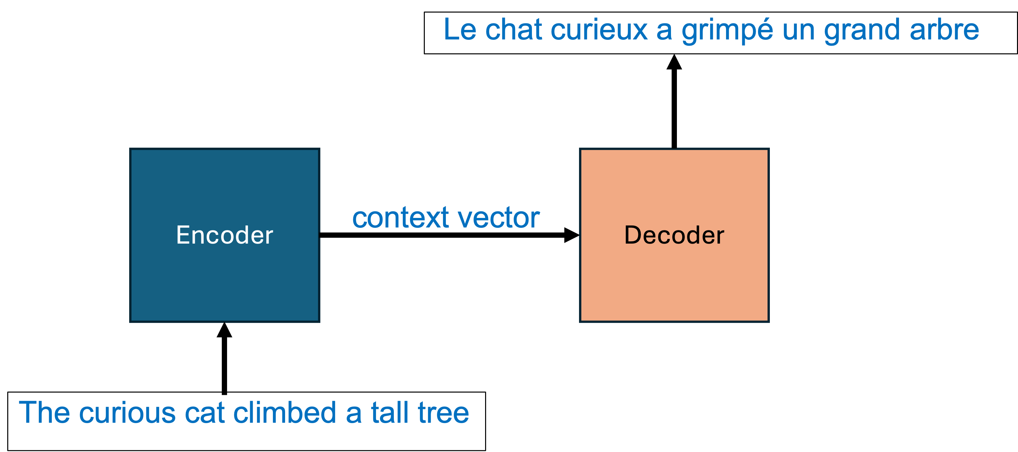
Seq 2 Seq Architecture
Step-by-step Process:
Decoder:
The decoder takes C and generates the output sequence in French
Step-by-step Process:
Encoder:
Tokenizes the input: [“The”, “curious”, “cat”, “climbed”, “a”, “tall”, “tree”].
Embeds each word into a vector.
Processes each embedding through layers, producing the context vector: C = [1.2, -0.7, 0.8,…..]
Context vector is a summarized vector of the entire input text.

Slide 7
Seq 2 Seq: Encoder Architecture
LSTM
LSTM
LSTM
LSTM
LSTM
LSTM
LSTM
h_{t}
C_{t}
The curious cat climbed a tall tree
timesteps
Step-by-step Process:
As in an LSTM, at timestep 1, the accepts “The” as input token and performs the mathematical transformation using the random weights of h_{t} & C_{t} from previous state and passes it on timestep 2, where the token “curious” is the second input.
The architecture continues to encode all the tokens into dense vectors as a single context vector C
Note: In encoder the LSTM cell can be a GRU but its never RNN

Slide 8
Seq 2 Seq: Decoder Architecture
Le chat curieux a grimpé un grand arbre <END>
h_{t}
LSTM
LSTM
LSTM
LSTM
LSTM
LSTM
LSTM
LSTM
LSTM
C_{t}
<START> Le chat curieux a grimpé un grand arbre
timesteps
Step-by-step Process:
Initialization:
Uses the context vector C from the encoder to initialize the decoder’s hidden state
The word <START> triggers the start of the decoding process and word <END> indicates the end of the process. These two words are additional tokens in the decoder architecture

Slide 9
Sequence to Sequence Models Training

Slide 10
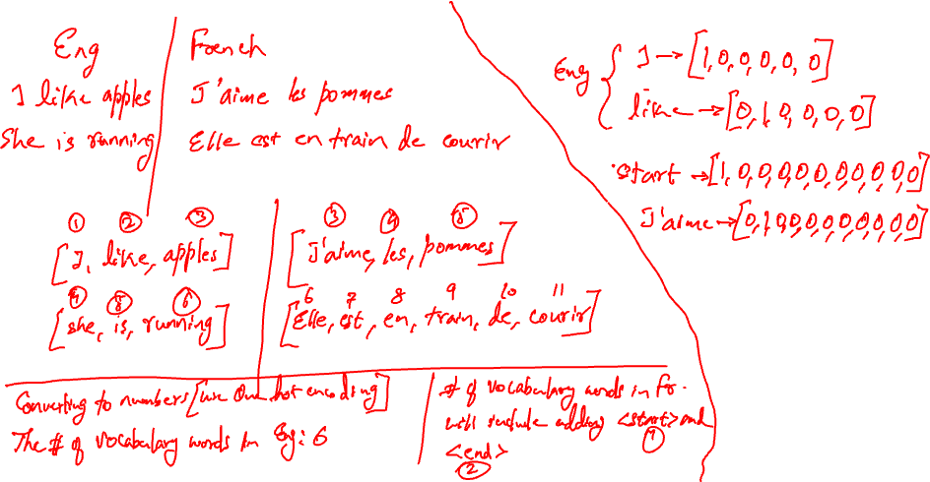

Slide 11
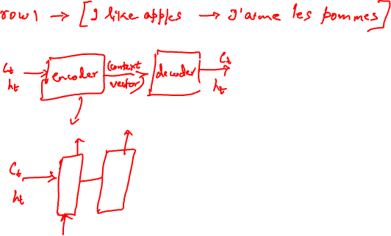

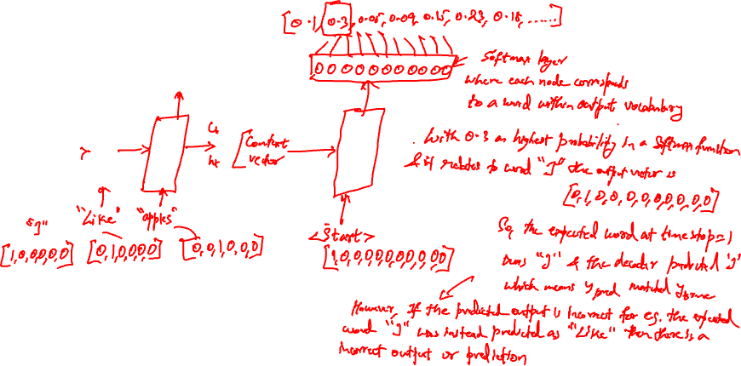
$$Ρ\left(yt | h, yt−1\right)=softmax(Wd∗st+by$$

Slide 12
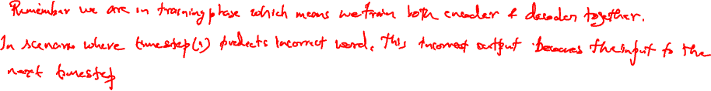
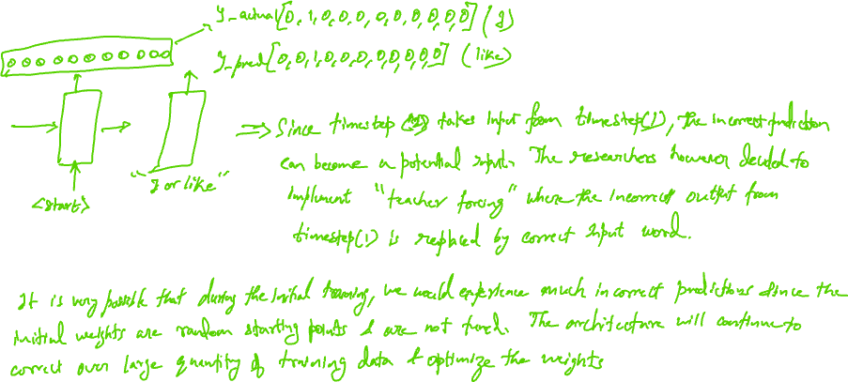

Slide 13
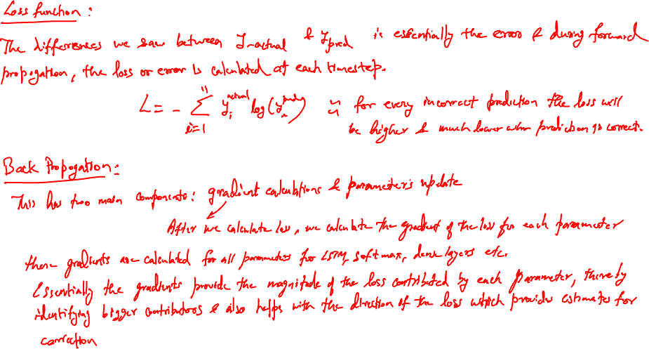
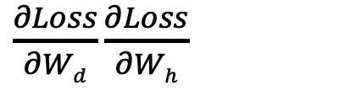
$\frac{∂Loss}{∂Wd}$ $\frac{∂Loss}{∂Wh}$

Slide 14
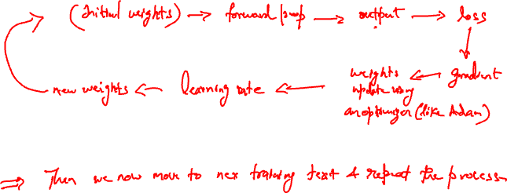
The training then moves to next sample text and repeats the above process

Slide 15
Seq2Seq Architecture: Improvements
LSTM
LSTM
LSTM
LSTM
LSTM
LSTM
LSTM
h_{t}
C_{t}
Low dimensional vectors
Low dim. vectors
Embedding layer
The curious cat climbed a tall tree
timesteps
Use Embeddings:
Allows capturing the context of the word in the sentence and as seen earlier, is big improvement over high dim. Sparse vectors as in One hot encoding
Allows use of pretrained embeddings such as Word2Vec to GloVe
Alternately allows training a localized embeddings for domain specific dataset

Slide 16
Final Architecture
SOFTMAX
h_{t}
LSTM
LSTM
LSTM
LSTM
LSTM
LSTM
LSTM
LSTM
C_{t}
Embedding layer
Embedding layer
2. Use deep layered LSTM
Add multiple LSTM layers stacked on both encoder & decoder
This is preferred especially for long term dependencies as a single context vector has limited ability to capture long term dependency as a summarized output
Allows addition of more weights and biases and therefore trainable parameters

Slide 17
Attention Mechanism

Slide 18
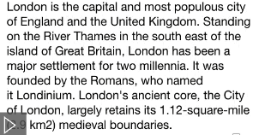
Long term dependencies: Limitations of Context Vector
Imagine translating a lengthy sentence:
Read this sentence once and translate it into another language. Humanely difficult to remember the entire text to translate it after reading it just once. This is how the Seq2Seq model approaches this entire sentence to encode it into a single context vector.
While this works for shorter sentences, for longer sequences, it’s like trying to compress an entire book into a single paragraph—important details are lost.
This is where the attention mechanism shines. Instead of relying solely on a fixed-length context vector, attention allows the decoder to dynamically focus on the most relevant parts of the input sequence during each prediction.

Slide 19
Limitations of Context Vector
Le chat a grimpe l’arbre hier <END>
Loss of Detailed Information:
Compressing all input information into a single vector limits the model’s ability to retain nuances, especially in long sequences.
Relationships between distant words also begins to diminish as sequences grow longer, leading to semantic errors
Misaligned Focus:
The decoder treats all input words equally, even though some words are more important than others for a given output.
E.g: The word “Yesterday” is at the start of the English sentence but moves to the end of the French translation (“hier”).
Solution:
Instead of relying solely on a fixed-length context vector, attention allows the decoder to dynamically focus on the most relevant parts of the input sequence during each prediction.
LSTM
LSTM
LSTM
LSTM
LSTM
LSTM
LSTM
<START> Le chat a grimpe l’arbre hier
LSTM
LSTM
LSTM
LSTM
LSTM
LSTM
Yesterday, the cat climbed the tree
timesteps

Slide 20
Attention Mechanism
Le chat a grimpe l’arbre hier <END>
Loss of Detailed Information:
Compressing all input information into a single vector limits the model’s ability to retain nuances, especially in long sequences.
Relationships between distant words also begins to diminish as sequences grow longer, leading to semantic errors
Misaligned Focus:
The decoder treats all input words equally, even though some words are more important than others for a given output.
E.g: The word “Yesterday” is at the start of the English sentence but moves to the end of the French translation (“hier”).
Solution:
Encode each word as context vector based on the focus on the text instead of entire text
LSTM
LSTM
LSTM
LSTM
LSTM
LSTM
LSTM
<START> Le chat a grimpe l’arbre hier
LSTM
LSTM
LSTM
LSTM
LSTM
LSTM
Yesterday, the cat climbed the tree
timesteps

Slide 21
Attention Mechanism
Le chat a grimpe l’arbre hier <END>
LSTM
LSTM
LSTM
LSTM
LSTM
LSTM
LSTM
<START> Le chat a grimpe l’arbre hier
LSTM
LSTM
LSTM
LSTM
LSTM
LSTM
Yesterday, the cat climbed the tree
timesteps

Slide 22
Attention Mechanism
Le chat a grimpe l’arbre hier <END>
LSTM
LSTM
LSTM
LSTM
LSTM
LSTM
LSTM
<START> Le chat a grimpe l’arbre hier
LSTM
LSTM
LSTM
LSTM
LSTM
LSTM
Yesterday, the cat climbed the tree
timesteps

Slide 23
Le chat a grimpe l’arbre hier <END>
LSTM
LSTM
LSTM
LSTM
LSTM
LSTM
LSTM
<START> Le chat a grimpe l’arbre hier
LSTM
LSTM
LSTM
LSTM
LSTM
LSTM
Yesterday, the cat climbed the tree
timesteps

Slide 24
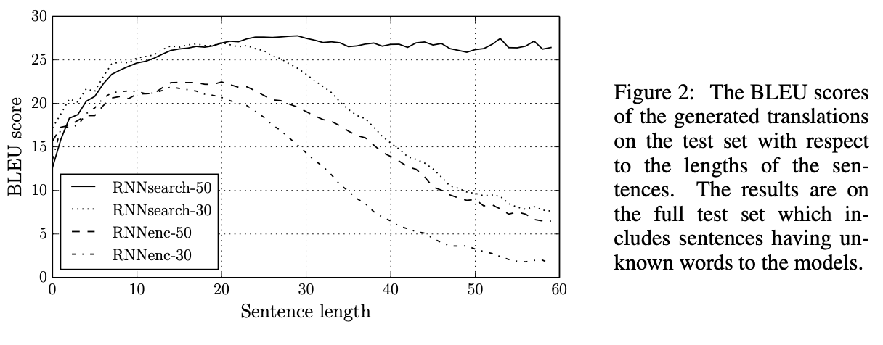
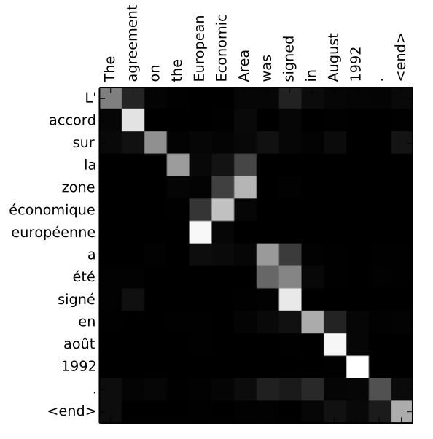
Models Performance using Attention

